Slide 1
Graphical Passwords
PRESENTATION - 2
Supriya Arun, Zack Davis, Joanna John

Slide 2

Agenda
UML Sequence Diagram
Use Case Diagram
Test Case Scenarios

Slide 3
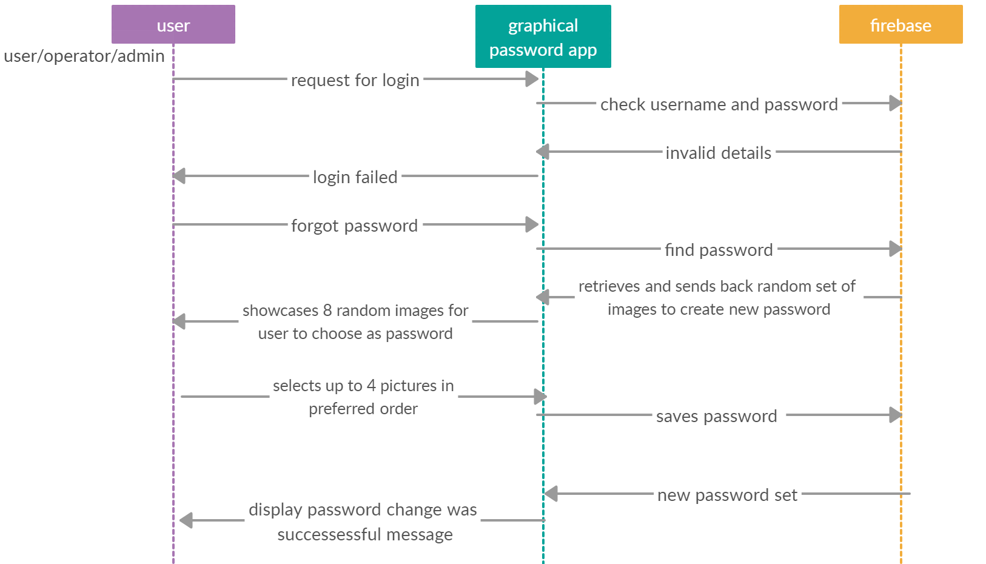
UML Sequence Diagram

Slide 4
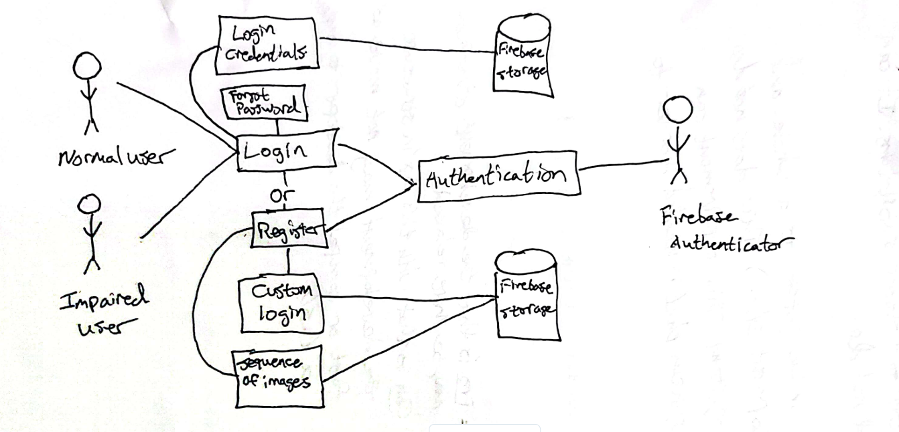
UML Case Diagram
Notes:
The next topic in our presentation will be our use case diagrams. The use case diagram is used to help identify the interactions between our system and the actors. In this case the diagrams show what the system does and not exactly how the system operates internally. In our first use case diagram we have types of users. One being the typical user for the system and the other being an impaired user. This application can help impaired users because this application is using a visual based authentication instead of text so it may be easier to use for impaired users. On the other side of the diagram we have some “actors” being our firebase authenticator and our firebase storage database. The authenticator will help with the obvious authentication process for logging in and password creation. The firebase storage aspect will store our user’s data and will keep the credentials alive so the user will stay logged in.The diagram shows our login and our registration phases. The login phase can include login credentials being input and our forgotten password implementation, each can be connected to the firebase storage. On the other side we have the registration that can include the custom login (meaning username, email, and graphical password sequence) that can be stored in the firebase storage.

Slide 5
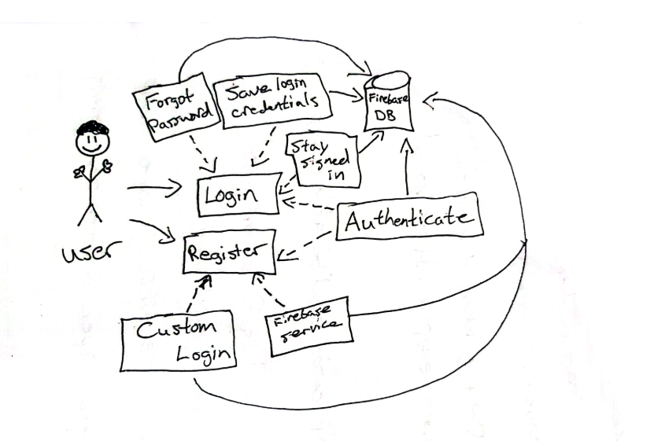
UML Case Diagram
Notes:
In this second user case diagram we have essentially the same structure as the previous diagram but the authentication and database are coupled in the firebase database service itself. We still have the user and we have the login/registration phases of the diagram that include the forgotten password, custom login credentials, the actual firebase service, etc.. Basically this is a little more condensed version of the previous diagram.

Slide 6
Test Case Scenarios
UI Test Scenario
- Verify that the application’s UI is responsive - adjusts to different screen
- Verify that all the labels on the text-boxes and buttons are present and clearly visible.
Functional Test Scenario
- Check that the user is not able to login with invalid username and password
- Verify that the user is able to select only 4 out of 8 pictures displayed
- Verify if the user has an option of “forgot password” on the login page
Notes:
Under UI testing we firstly need to test if its responsive meaning a user can interact with the application. For example, clicking on forgot password will lead to a page where they will have to enter their username and email and so on.
Secondly we have to check that all the labeling on the buttons and text boxes are visible for the user. For example, username text box should have visible enough for the user to know that they have to enter username.
For functional test cases we firstly need to check that invalid credentials will not let the user login.
Secondly we have to check that the user is able to pick only 4 out of 8 pictures for their password
Lastly to check if there is a forgot password option on the login page.

Slide 7
Thank you

